Slide 1
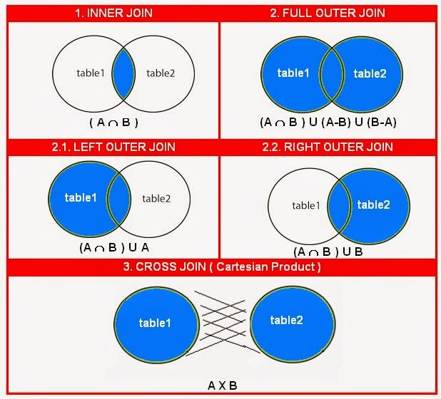
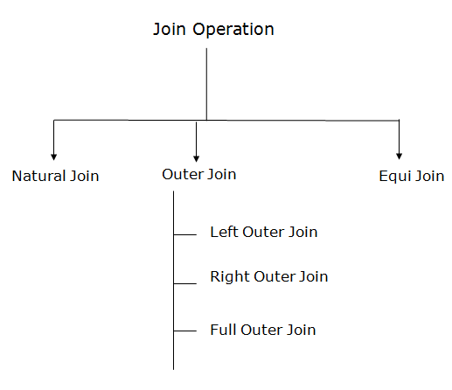
  Join

Slide 2
Renaming
Changes the schema, not the instance
Notation: ρ _{B1,…,Bn} (R)
Example:
  ρ_{LastName, SocSocNo} (Employee)
  Output schema:
  Answer(LastName, SocSocNo)

Slide 3
Renaming Example
Employee
Name
SSN
John
999999999
Tony
777777777
    _{LastName, Soc-No} (Employee)
LastName
Soc-No
John
999999999
Tony
777777777

Slide 4
Natural Join
Notation: R1 |×| R2
Meaning: R1 |×| R2 = Π_{A}(σ_{C}(R1 × R2))
Where:
  The selection σ_{C} checks equality of all common attributes
  The projection eliminates the duplicate common attributes

Slide 5
Natural Join Example
Employee
Name
SSN
John
999999999
Tony
777777777
Dependents
SSN
Dname
999999999
Emily
777777777
Joe
Employee Dependents =
Π_{Name, SSN, Dname} (σ _{SSN=EmployeeSSN} (Employee x ρ_{EmployeeSSN, Dname}(Dependents)))
Name
SSN
Dname
John
999999999
Emily
Tony
777777777
Joe

Slide 6
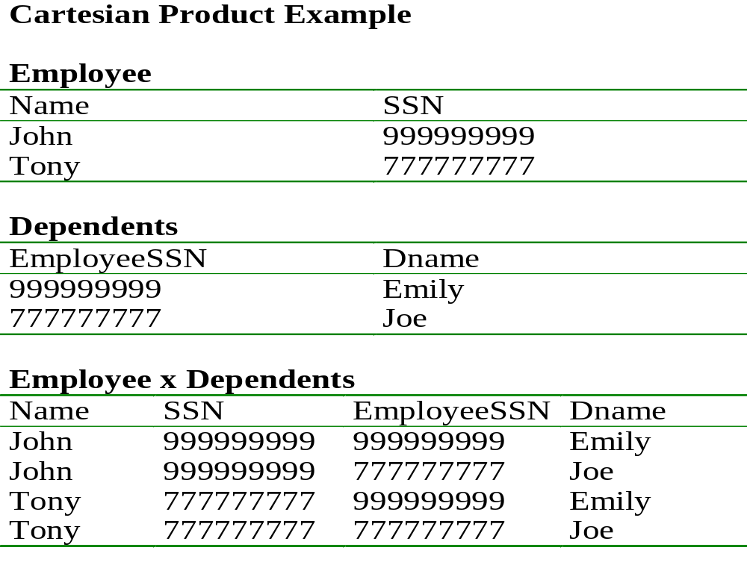
(Employee x ρ_{EmployeeSSN, Dname}(Dependents))

Slide 7
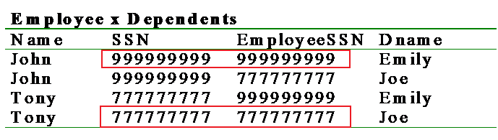
join-cond has the form:
A₁ = A₁ AND … AND A_{n} = A_{n}
where {A₁ … A_{n}} = attributes(R) ∩ attributes(S)
(σ _{SSN=EmployeeSSN} (Employee x ρ_{EmployeeSSN,Dname}(Dependents)) )

Slide 8
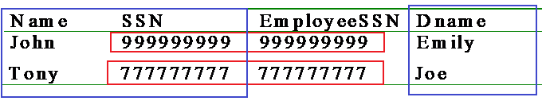
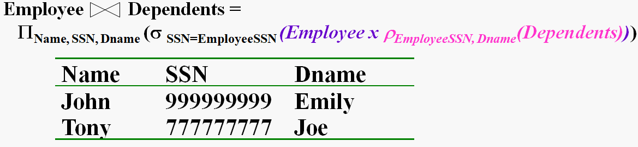
attr-list = attributes (R) ∪ attributes (S)

Slide 9
Natural Join (con’t)
More generally:
R
S = π_{attr-list} (σ_{join-cond} (R × S) )
where
attr-list = attributes (R) ∪ attributes (S)
(duplicates are eliminated) and
join-cond has the form:
A₁ = A₁ AND … AND A_{n} = A_{n}
where {A₁ … A_{n}} = attributes(R) ∩ attributes(S)

Slide 10
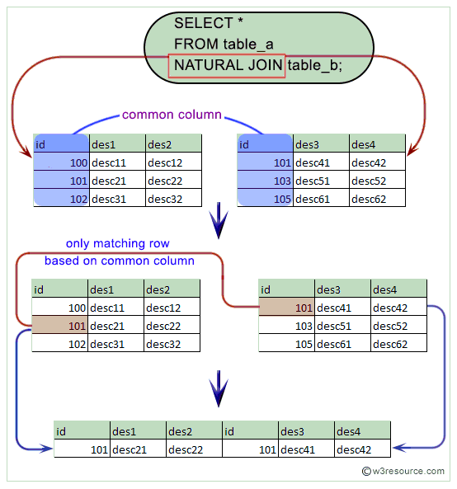

Slide 11
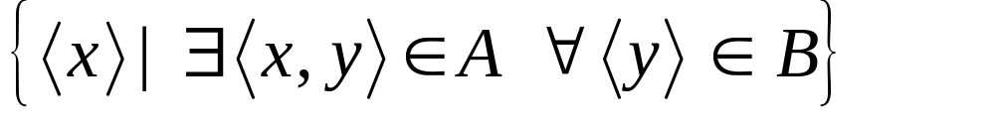

Division
Not supported as a primitive operator, but useful for expressing queries like: Find sailors who have reserved all boats.
Let A have 2 fields, x and y; B have only field y:
  A/B =
  i.e., A/B contains all x tuples (sailors) such that for every y tuple (boat) in B, there is an xy tuple in A.
  Or: If the set of y values (boats) associated with an x value (sailor) in A contains all y values in B, the x value is in A/B.
In general, x and y can be any lists of fields; y is the list of fields in B, and x y is the list of fields of A.
Notes:
13

Slide 12
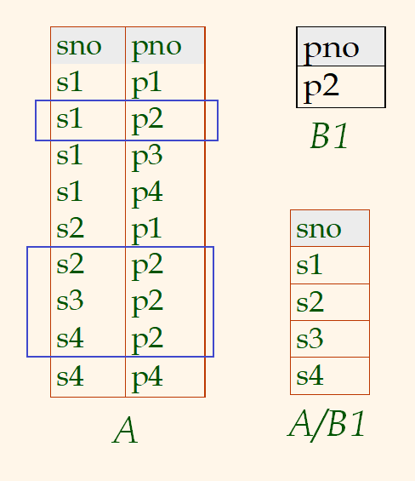
Examples of Division A/B
Notes:
14

Slide 13
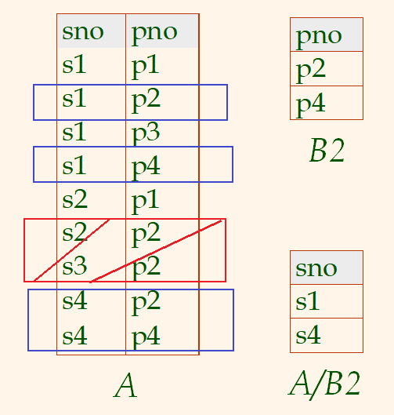
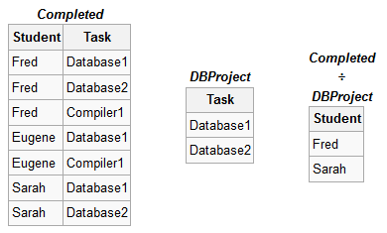
Examples of Division A/B
Notes:
14

Slide 14
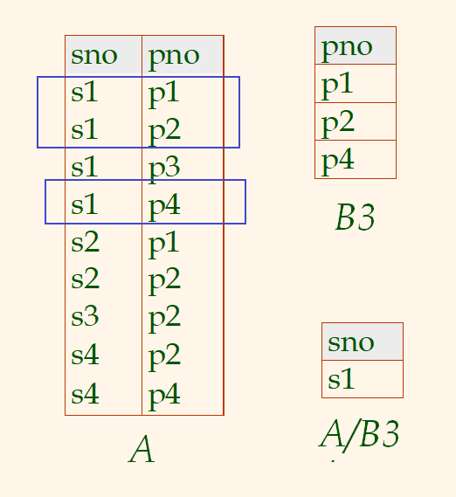
Examples of Division A/B
Notes:
14

Slide 15
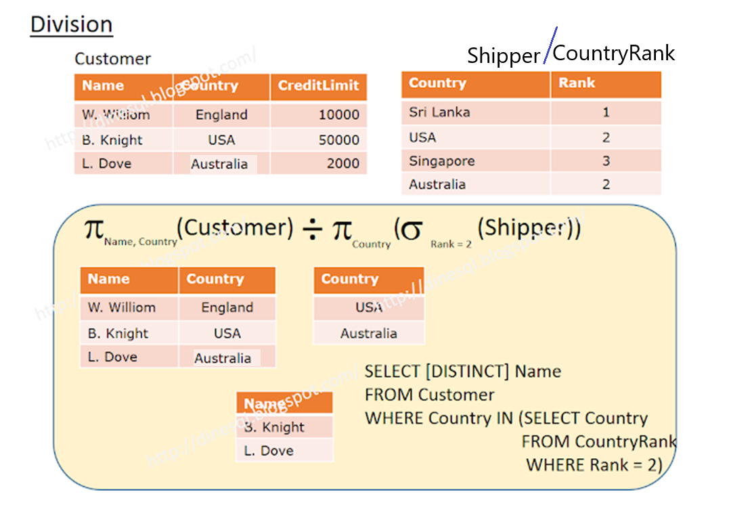
Which customers are registered from ALL the countries ranked as 2.

Slide 16
Example of Division
Find all customers who have an account at all branches located in Chennai
  Branch (bname, assets, bcity)
  Account (bname, acct#, cname, balance)
Notes:
14

Slide 17
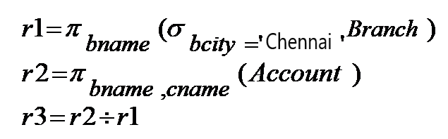
Example of Division
R1: Find all branches in Chennai
R2: Find (bname, cname) pair from Account
R3: Customers in r2 with every branch name in r1
Notes:
14

Slide 18
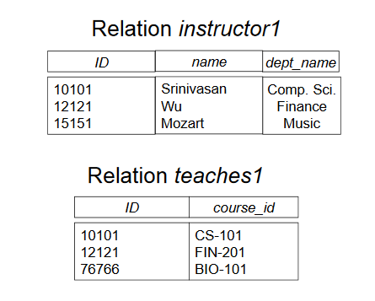
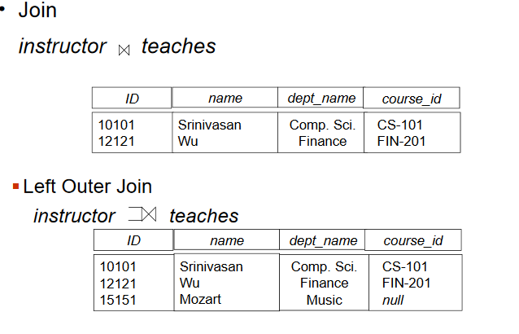
Outer Join

Slide 19
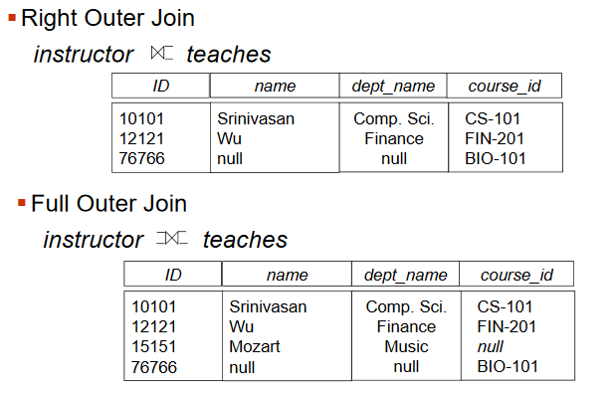
Outer Join

Slide 20
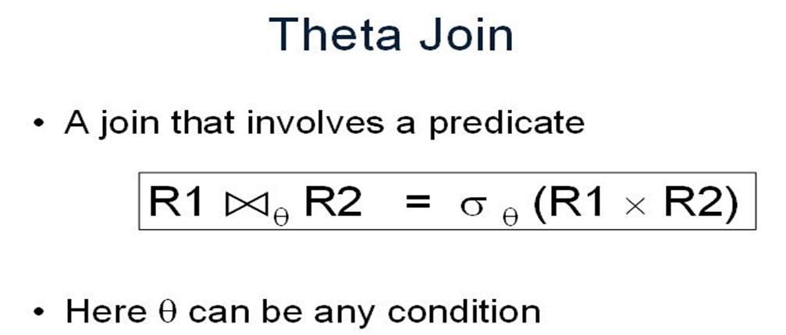
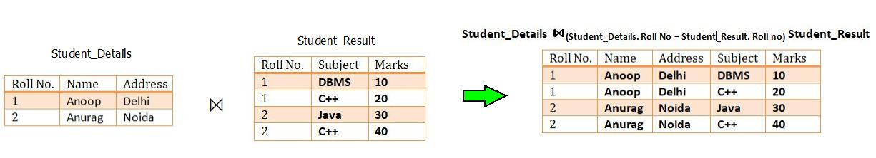
This is based on a Predicate added to a Cartesian Product.
In simple term, if you have joined two tables using CROSS JOIN, then you can add a filter to the result using one of the Relational operators(<,>,<=,>=,=, !=).
Note that it can be implemented using SELECTION over a Cartesian Product as well.

Slide 21
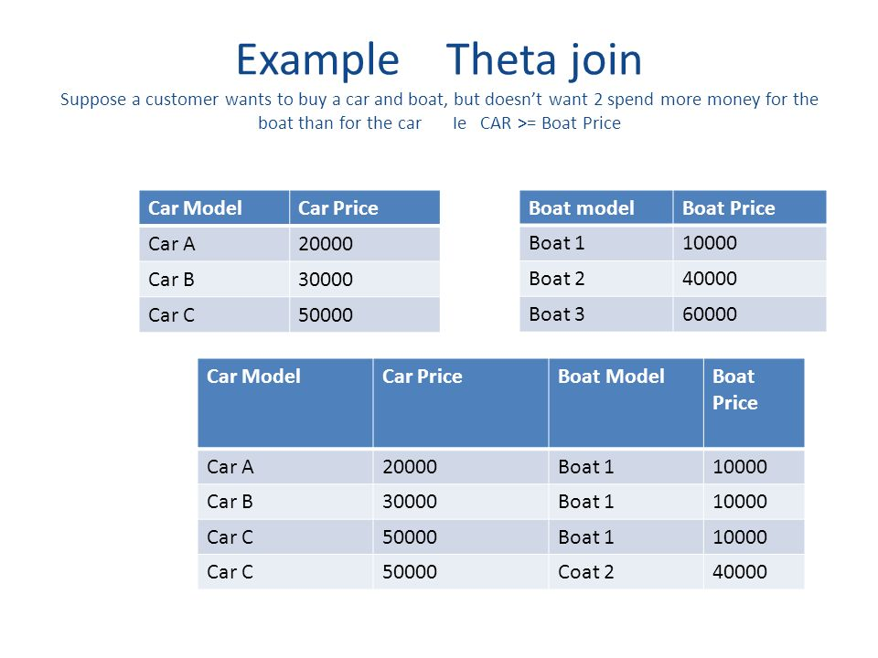

Slide 22
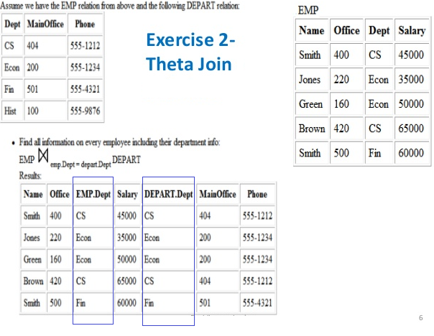

Slide 23
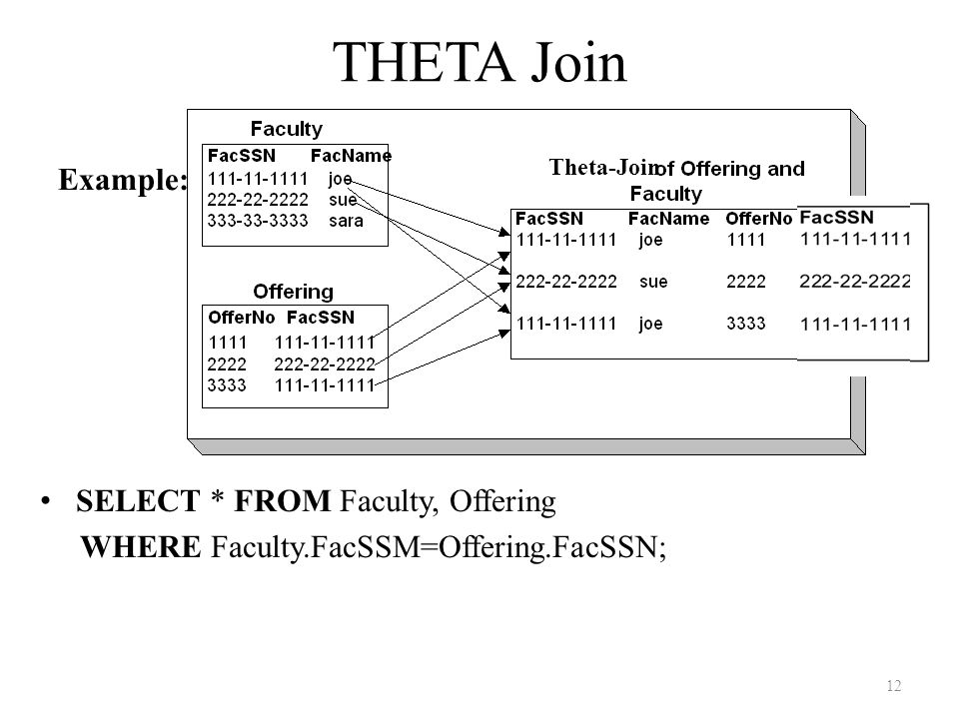

Slide 24
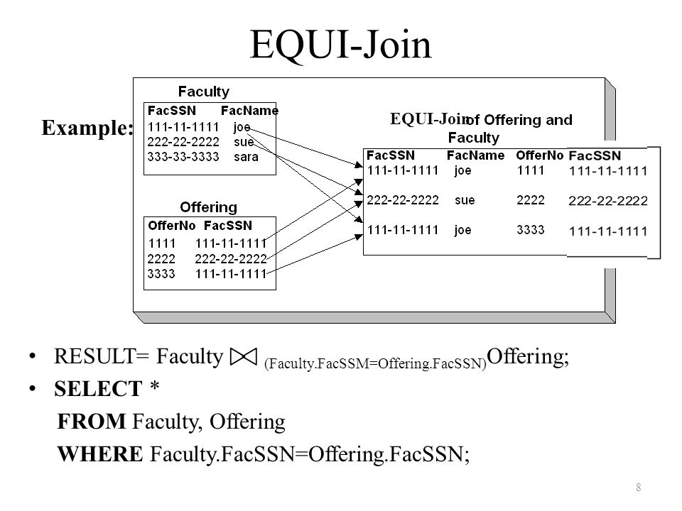
Equijoin
This is same as Theta Join but the comparison operator is equal.
Generally, if the operator of the Theta Join is equal operator (=), then the join is called as Equijoin instead of Theta Join.

Slide 25
